Slide 1
Introduction of
Direct Memory Access (DMA)

Slide 2
Why is DMA?
It is wasteful to feed data into a controller register 1 bytes at a time. (PIO)
The DMA unit is word.
In the high loading environment, a system with DMA has better improvement.

Slide 3
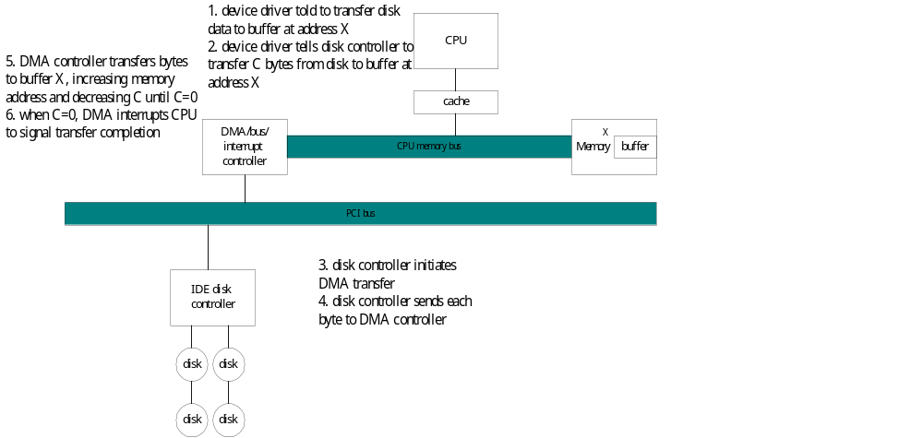
DMA transfer

Slide 4
DMA Progress
To initiate a DMA transfer, the host writes a DMA command into memory:
  A pointer to the source of a transfer
  A count of the number of bytes to be transferred
  ……..
The CPU writes the address of the DMA command block to the DMA controller.

Slide 5
DMA Progress (cont.)
The DMA controller proceeds to operate the memory bus directly without CPU help.
Handshaking exists between DMA controller and device controller.
When the entire transfer is finished, the DMA controller will interrupts the CPU.

Slide 6
Handshaking
DMA-request and DMA_acknowledge
  When a word of data is available, the device controller places a signal on the DMA-request wire.
  The signal causes the DMA controller to seize the memory bus,
    To place the desired address on the memory-address wire
    To place a signal on the DMA-acknowledge wire

Slide 7
Handshaking (cont.)
When the device controller receives the DMA-acknowledge signal,
  it transfer the word of data to memory
  and remove the DMA_request signal.

